Slide 1
PDM/PLM
15.10.2014
Kaur Jaakma

Slide 2
Abbreviation
PDM
Product Data Management
Tuotetiedonhallinta
PLM
Product Lifecycle Management
Tuotteen elinkaaren hallinta
Includes PDM
Sometimes used as synonym
DMS
Document Management System

Slide 3
Product Data Management

Slide 4
History
Late 1980s : Growing volumes of design files generated by CAD
First custom EDM (Engineering Data Management) system appears.
Soon commercial software renamed PDM (Product Data Management).
Main functions: Incremental saving + versioning

Slide 5
Evolution in PDM
Lots of CAD
Data management functionalities
Lots of DESIGNER
Need to support Concurrent Engineering (CE)
Switch from CAD as engineering artifact to CAD as official document
Support for Bill of Materials (BOM) and integration with Enterprise Resource Planning (ERP)

Slide 6
Reasons to Have PDM
Simultaneous design
Who has the right version?
Several office locations
Data in one place
Subcontractors
Can share their files
Harmonize design process
Encourage to use certain workflow and methods

Slide 7
Core Functions
Data Storage
Uses systematic way to store product related data
Product, Project, Library…
Search
Using search rules to find needed data
Access Control
Who, where, what can do?
Change Management
”Where used” quarry
What changed and why?

Slide 8
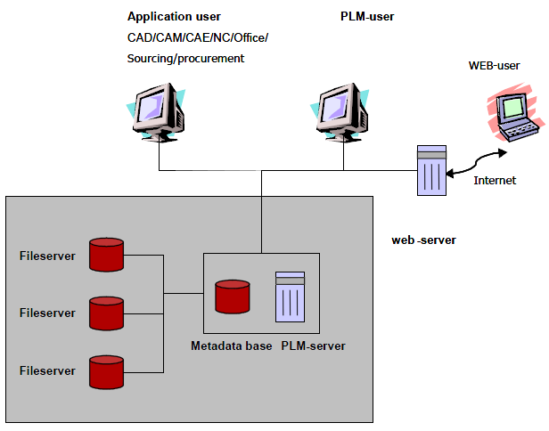
Architecture of PDM

Slide 9
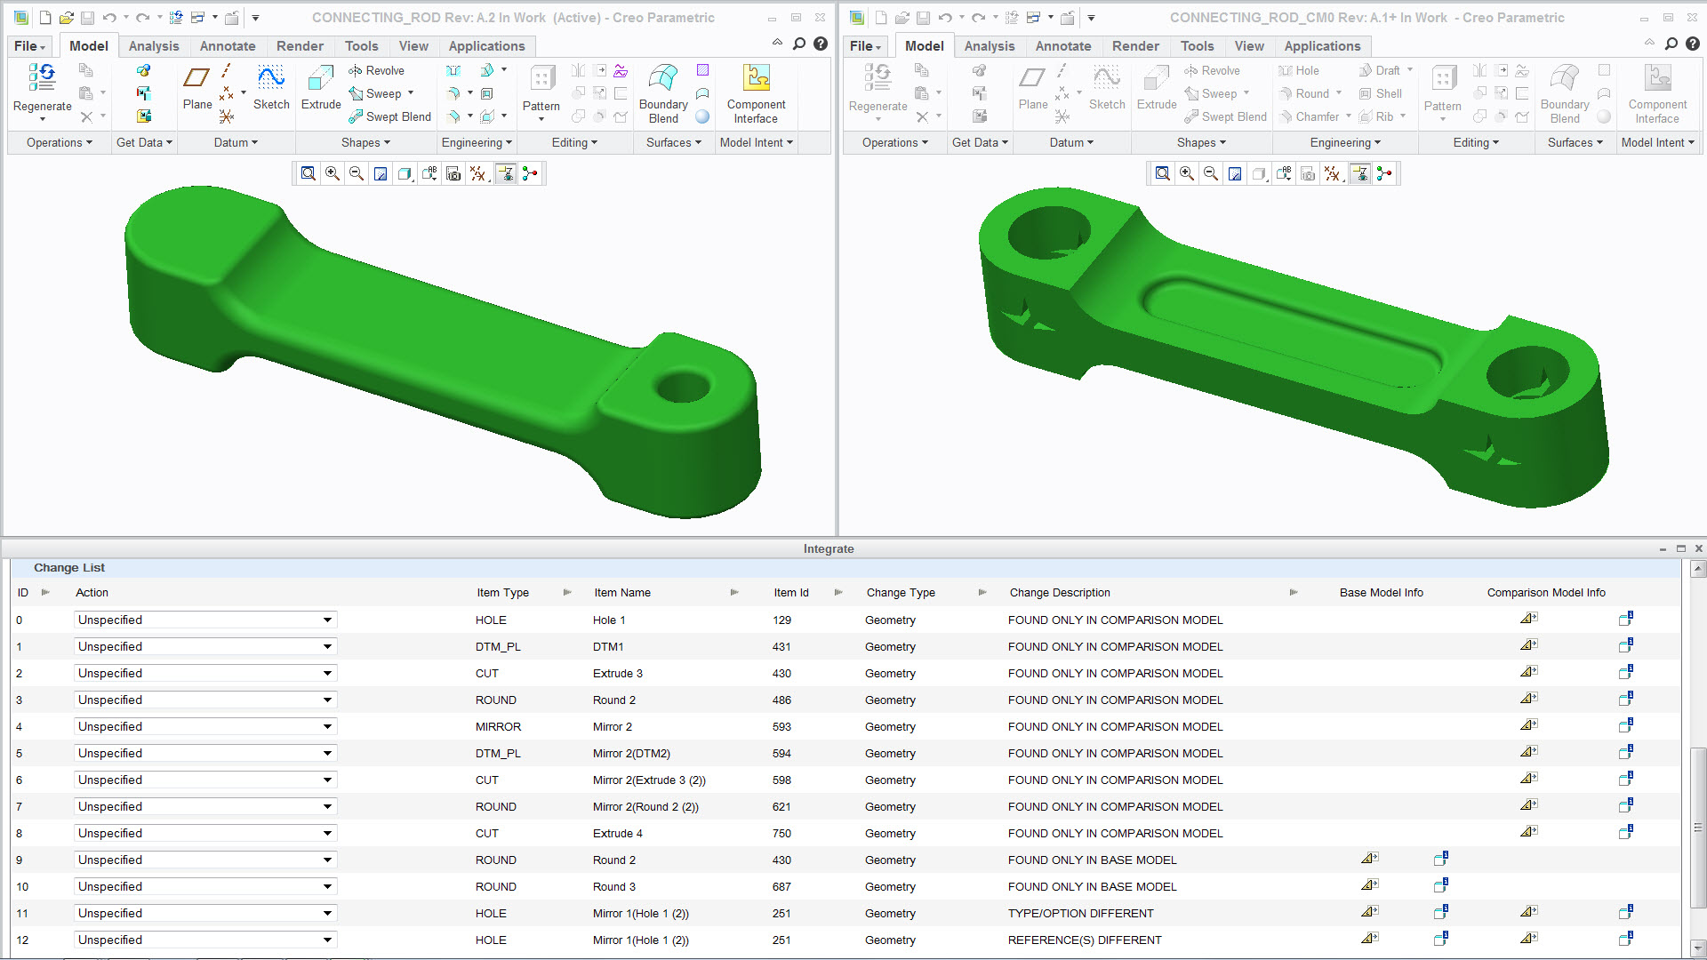
Change Management

Slide 10
Core Functions
Object handling
Check-in/check-out mechanism
Version control
Concurrent design
Data Lifecycle
In design / production / maintenance
Depending on company’s policies and data type
Data workflow
Series of actions that must be taken upon change in the lifecycle status of the data

Slide 11
Object Handling
Check-in
Puts object into system
New version
Check-out
Loads data from system
User have right to change object
Locks from other users (read-only)
Version not changed
If canceled, nothing changes

Slide 12
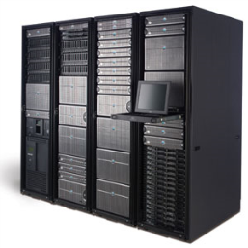

Version Control
Check-in
1.3
Normally in X.Y format
X is revision
Main version
For ex. new part to assembly
Y is version
Check-in creates new version
For ex. part location changed
Depended on company policies
1.2
1.2+
1.2
Check-out

Slide 13
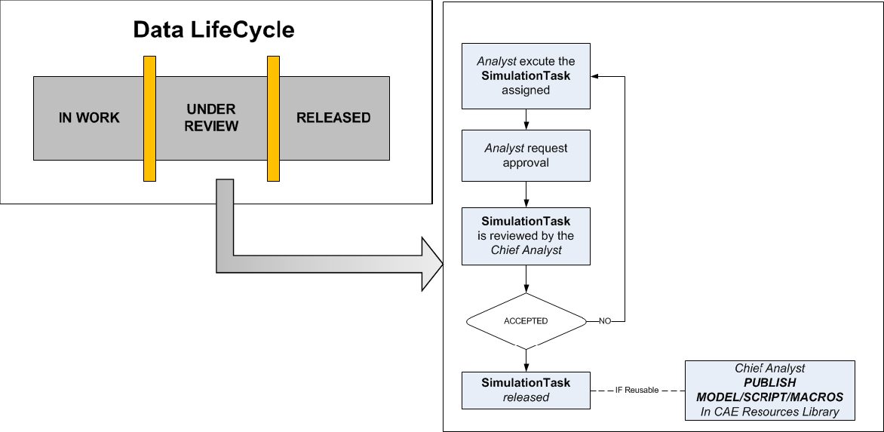
Data Lifecycle and Workflow Example

Slide 14
Core Functions
Product structure management and maintenance
Information that resemble the product structure, which consists of items hierarchically connected together
Assembly’s model tree and custom folders
Configuration management
Varying the physical properties of similar products and switching interchangeable assemblages or components. Configuration management allows products to be customized according to customer wishes
CAD’s family table!

Slide 15
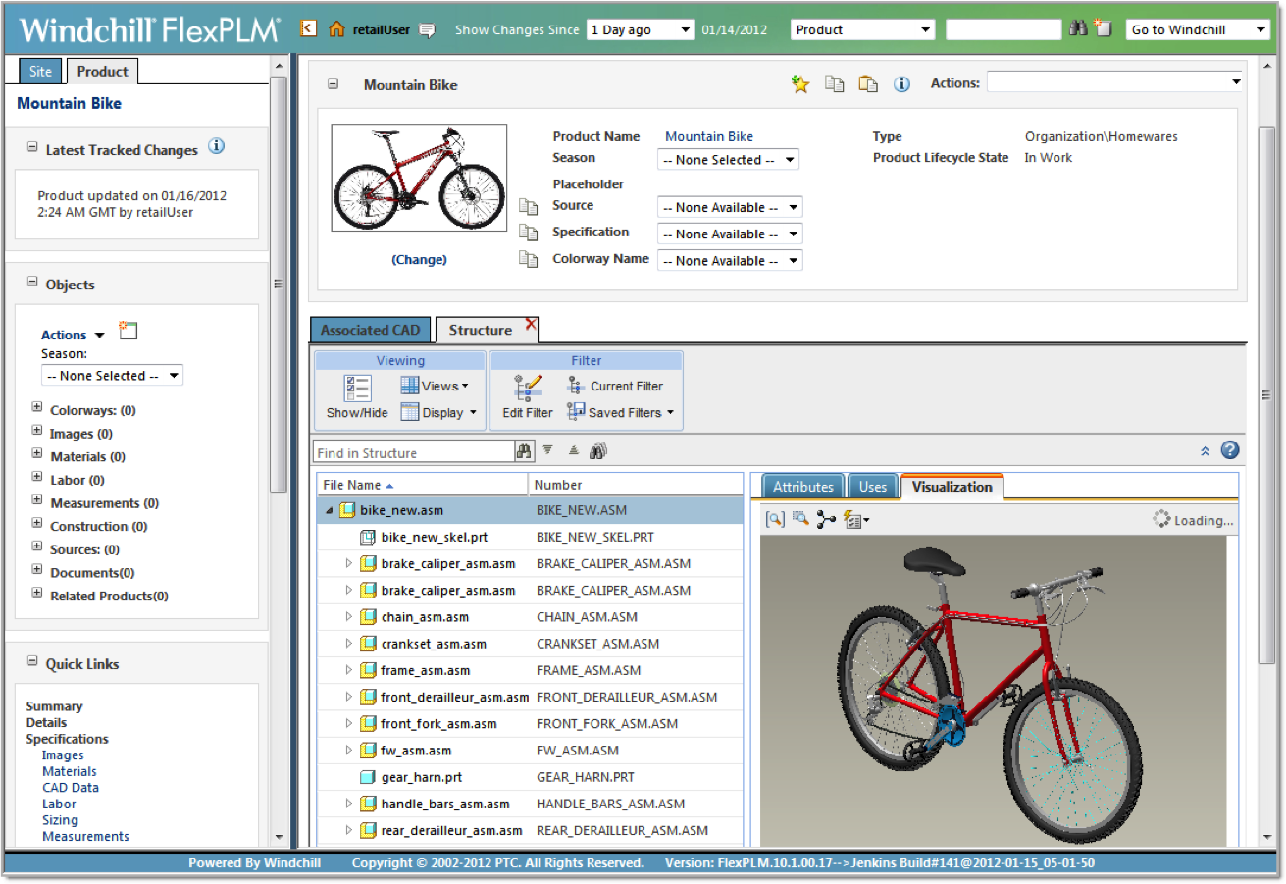
Product Structure

Slide 16
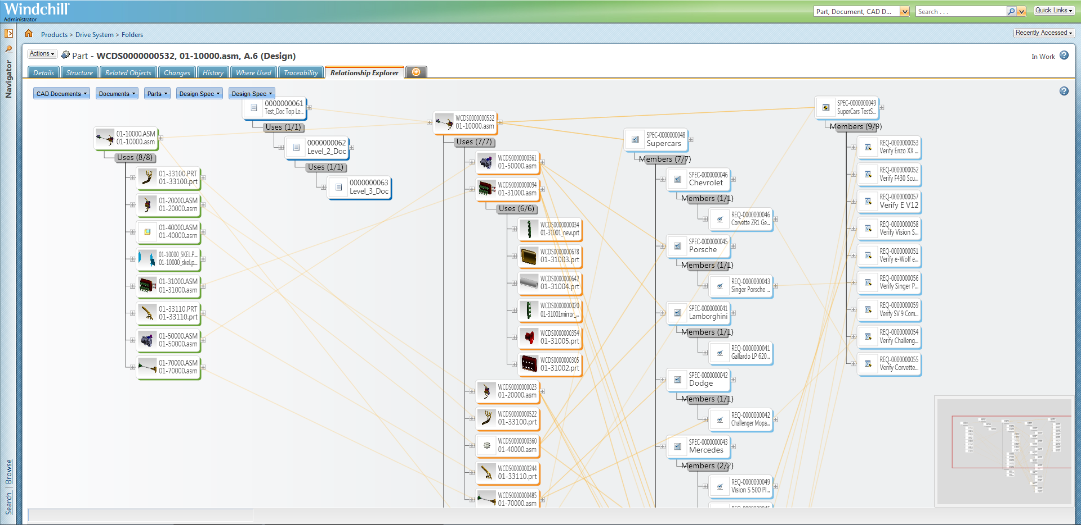
Object Relationships

Slide 17
Version Control in PTC Creo
No overwriting
New version with every save
Simple offline version control system
Can set privacy settings to files
Works with almost every file format
prt.#, asm.#, sec.#, txt.#
Can be connected to PDM system

Slide 18
Product Lifecycle Management

Slide 19
PLM is NOT a Software!
Product lifecycle management does not refer to any individual computer software or method. It is a wide functional totality; a concept and set of systematic methods that attempts to control the product information.
However, in practice, PLM is carried out almost without exception with the help of different information processing systems

Slide 20
What Is PLM? One Definition
“The core of product lifecycle management is the creation, preservation and storage of information relating to the company’s products and activities, in order to ensure the fast, easy and trouble-free finding, refining, distribution and reutilization of the data required for daily operations.”
Sääksvuori & Immonen. 2008. Product Lifecycle Management.

Slide 21
What Is PLM?
PLM is a holistic business concept
Items and documents
BOM’s
Environmental component information
Quality standards
Engineering requirements
Change orders
Manufacturing procedures
Product performance information
Component suppliers
Workflows (company’s internal procedure)
Project control
Etc.

Slide 22
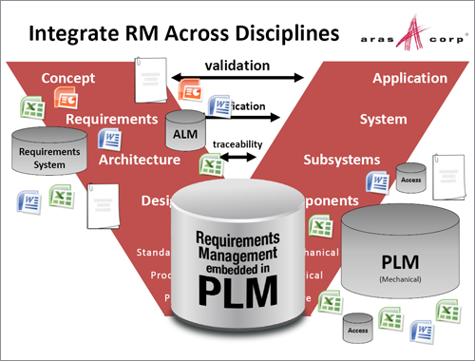
Requirements Management

Slide 23
What Is PLM?
Modern PLM system helps standardize, automate, and speed up operations.
Web based systems enable companies easily to connect their globally dispersed facilities with each other and with outside organizations such as suppliers, partners, and even customers.
PLM is a collaborative backbone allowing people throughout extended enterprises to work together more effectively.

Slide 24
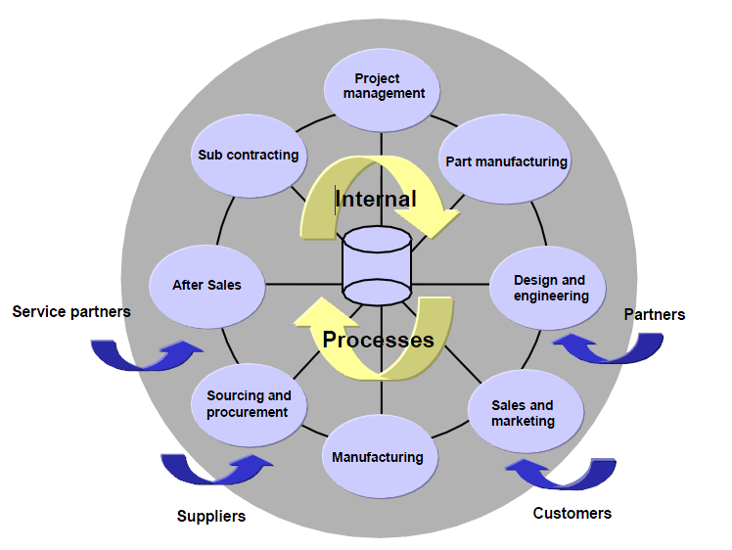
PLM Functions

Slide 25
Example: Siemens Teamcenter

Slide 26
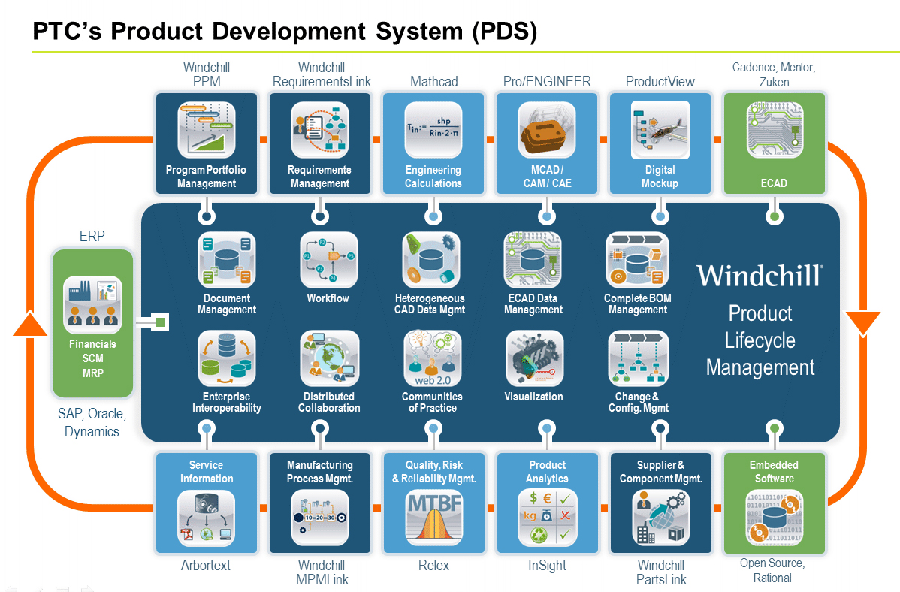
Another Example: PTC Windchill

Slide 27
Final Remark about PLM
PLM is wide concept, related with:
Engineering data management
Enterprise processes
Business and marketing of the product
Companies tends to deploy the PDM system provided by the same vendor of the CAD software
Other PLM functionalities are usually provided by specialized software
Integrating different specialized software is often complicated an expensive

Slide 28
Similar Concepts

Slide 29
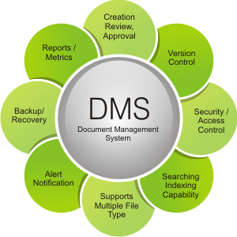
Document Management Systems
Tracking and storing documents
Word-, Excel-, PDF- etc. files
Like PDM but for non-CAD files
Data storing
Searching & indexing
Data locks
Versioning
Collaboration
Etc.

Slide 30
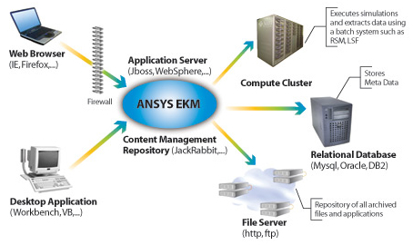
Simulation Data/Lifecycle Management
Data management system for handling simulation data
Very large objects
Result files
Simulation models
Scripts
Etc.
Layer to run simulations
Querying
Dedicated simulation server(s)
Should be part of commercial PLM

Slide 31
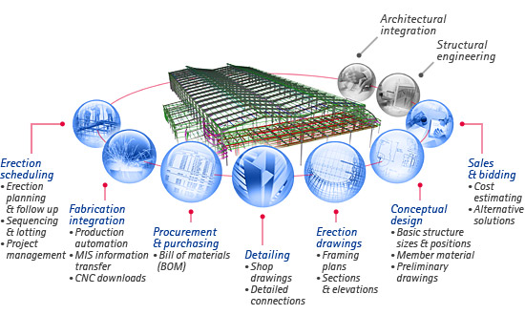
Building Information Management
Used in civil engineering
Similar to PDM
Project based
Unique products

Slide 32
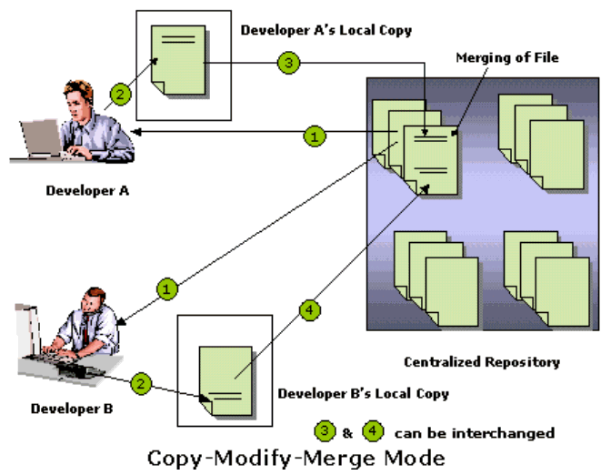
Concurrent Versioning System
Used in computer engineering
More weight on parallel working
Can change same file(s)

Slide 33
Vendors & Software

Slide 34
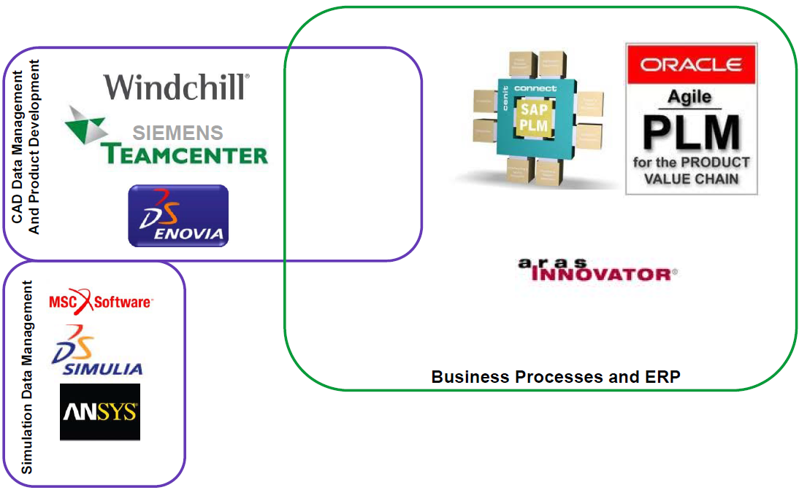

Some Commercial PDM/PLM

Slide 35

MS SharePoint
Document Management System (DMS) from Microsoft
Integration to Office tools
Web usage
Possibility to expand
SDM system plausible based on it
PTC ProductPoint
Until the release of Windchill 10
Based on SharePoint technology

Slide 36
References (Pictures)
http://communities.ptc.com/servlet/JiveServlet/showImage/38-1748-23896/Layout+of+the+Windows.jpg
http://communities.ptc.com/servlet/JiveServlet/showImage/38-2227-30215/View+CAD+structure+directly+in+FlexPLM.png
http://communities.ptc.com/servlet/JiveServlet/downloadImage/38-2227-30209/Easily+view+interconnected+product+information+with+the+Relationship+Explorer.png
http://www.aras.com/plm-images/documents/slides/500x350-aras-plm-next-gen-req-mgt.png
http://www.ayokasystems.com/wp-content/uploads/siemens-550x280.jpg
https://encrypted-tbn3.gstatic.com/images?q=tbn:ANd9GcTaPHlkNTd1Ep-PNh7vx5Xnym2gFAGeZdpulKj1m0iiPC8M1o_Y
http://wildeanalysis.co.uk/system/photos/657/preview/ansys-ekm.jpg?1271444143
http://www.dowcotech.com/imgs/test/bim-steel.jpg
http://media.developeriq.in/media__/images/v_c2_24_07_09.gif
http://www.shorzinternational.com/contents/images/products/PDSDL.jpg

